Slide 1

Being an Android Big-Cheese
and the
Path to Great Success
AN AMAZING KEYNOTE BY
PAUL LAMMERTSMA

Slide 4
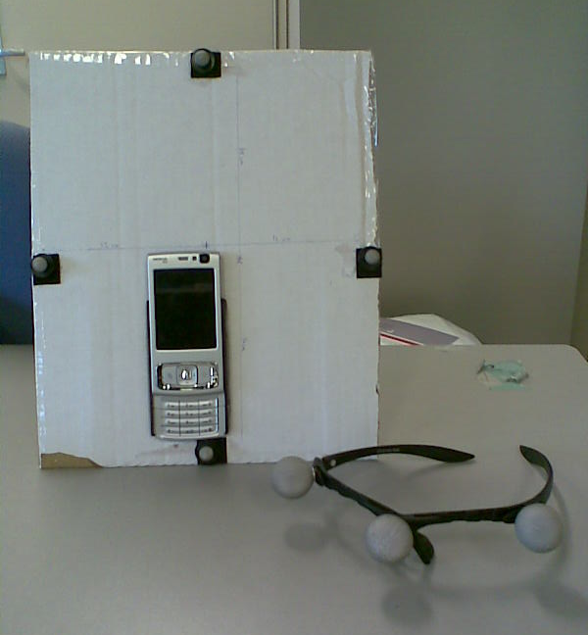
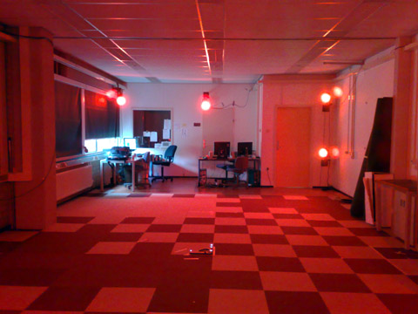
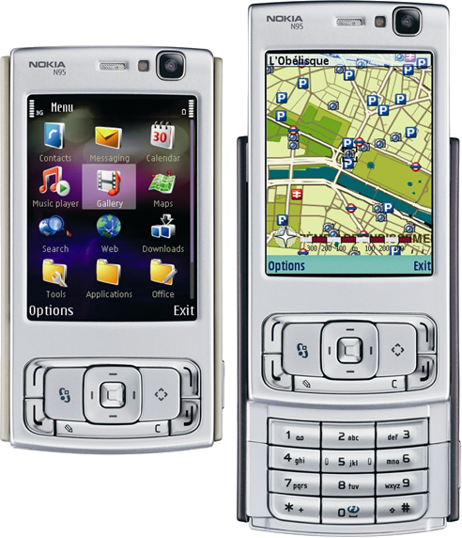
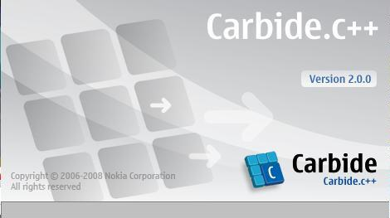
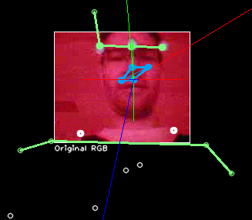
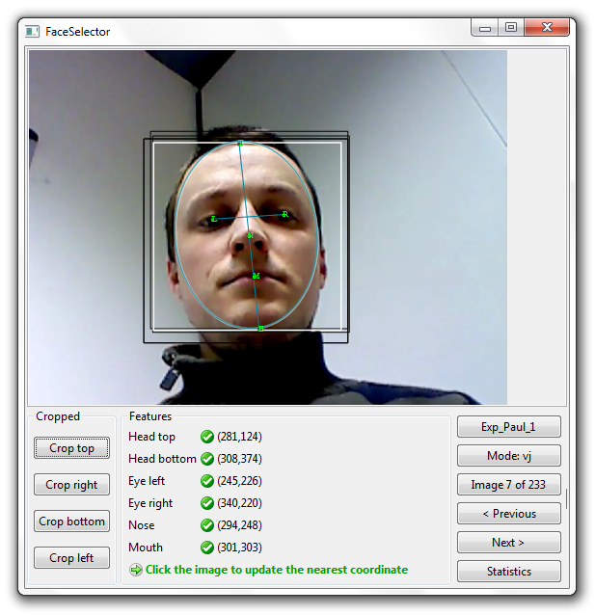
2007
Nokia N95
Symbian OS, S60

Slide 5
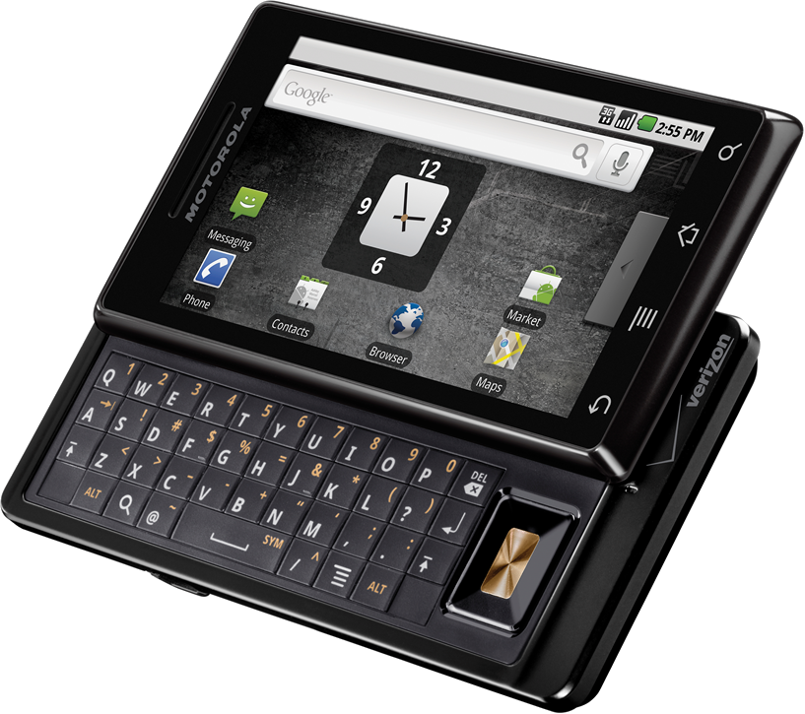
2008
Motorola Droid
Android 2.0 (Eclair)

Slide 6
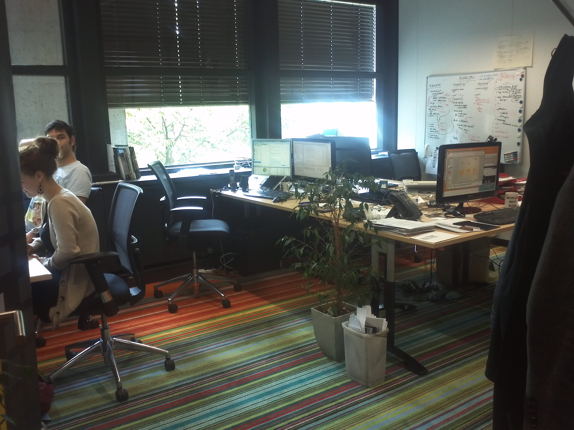
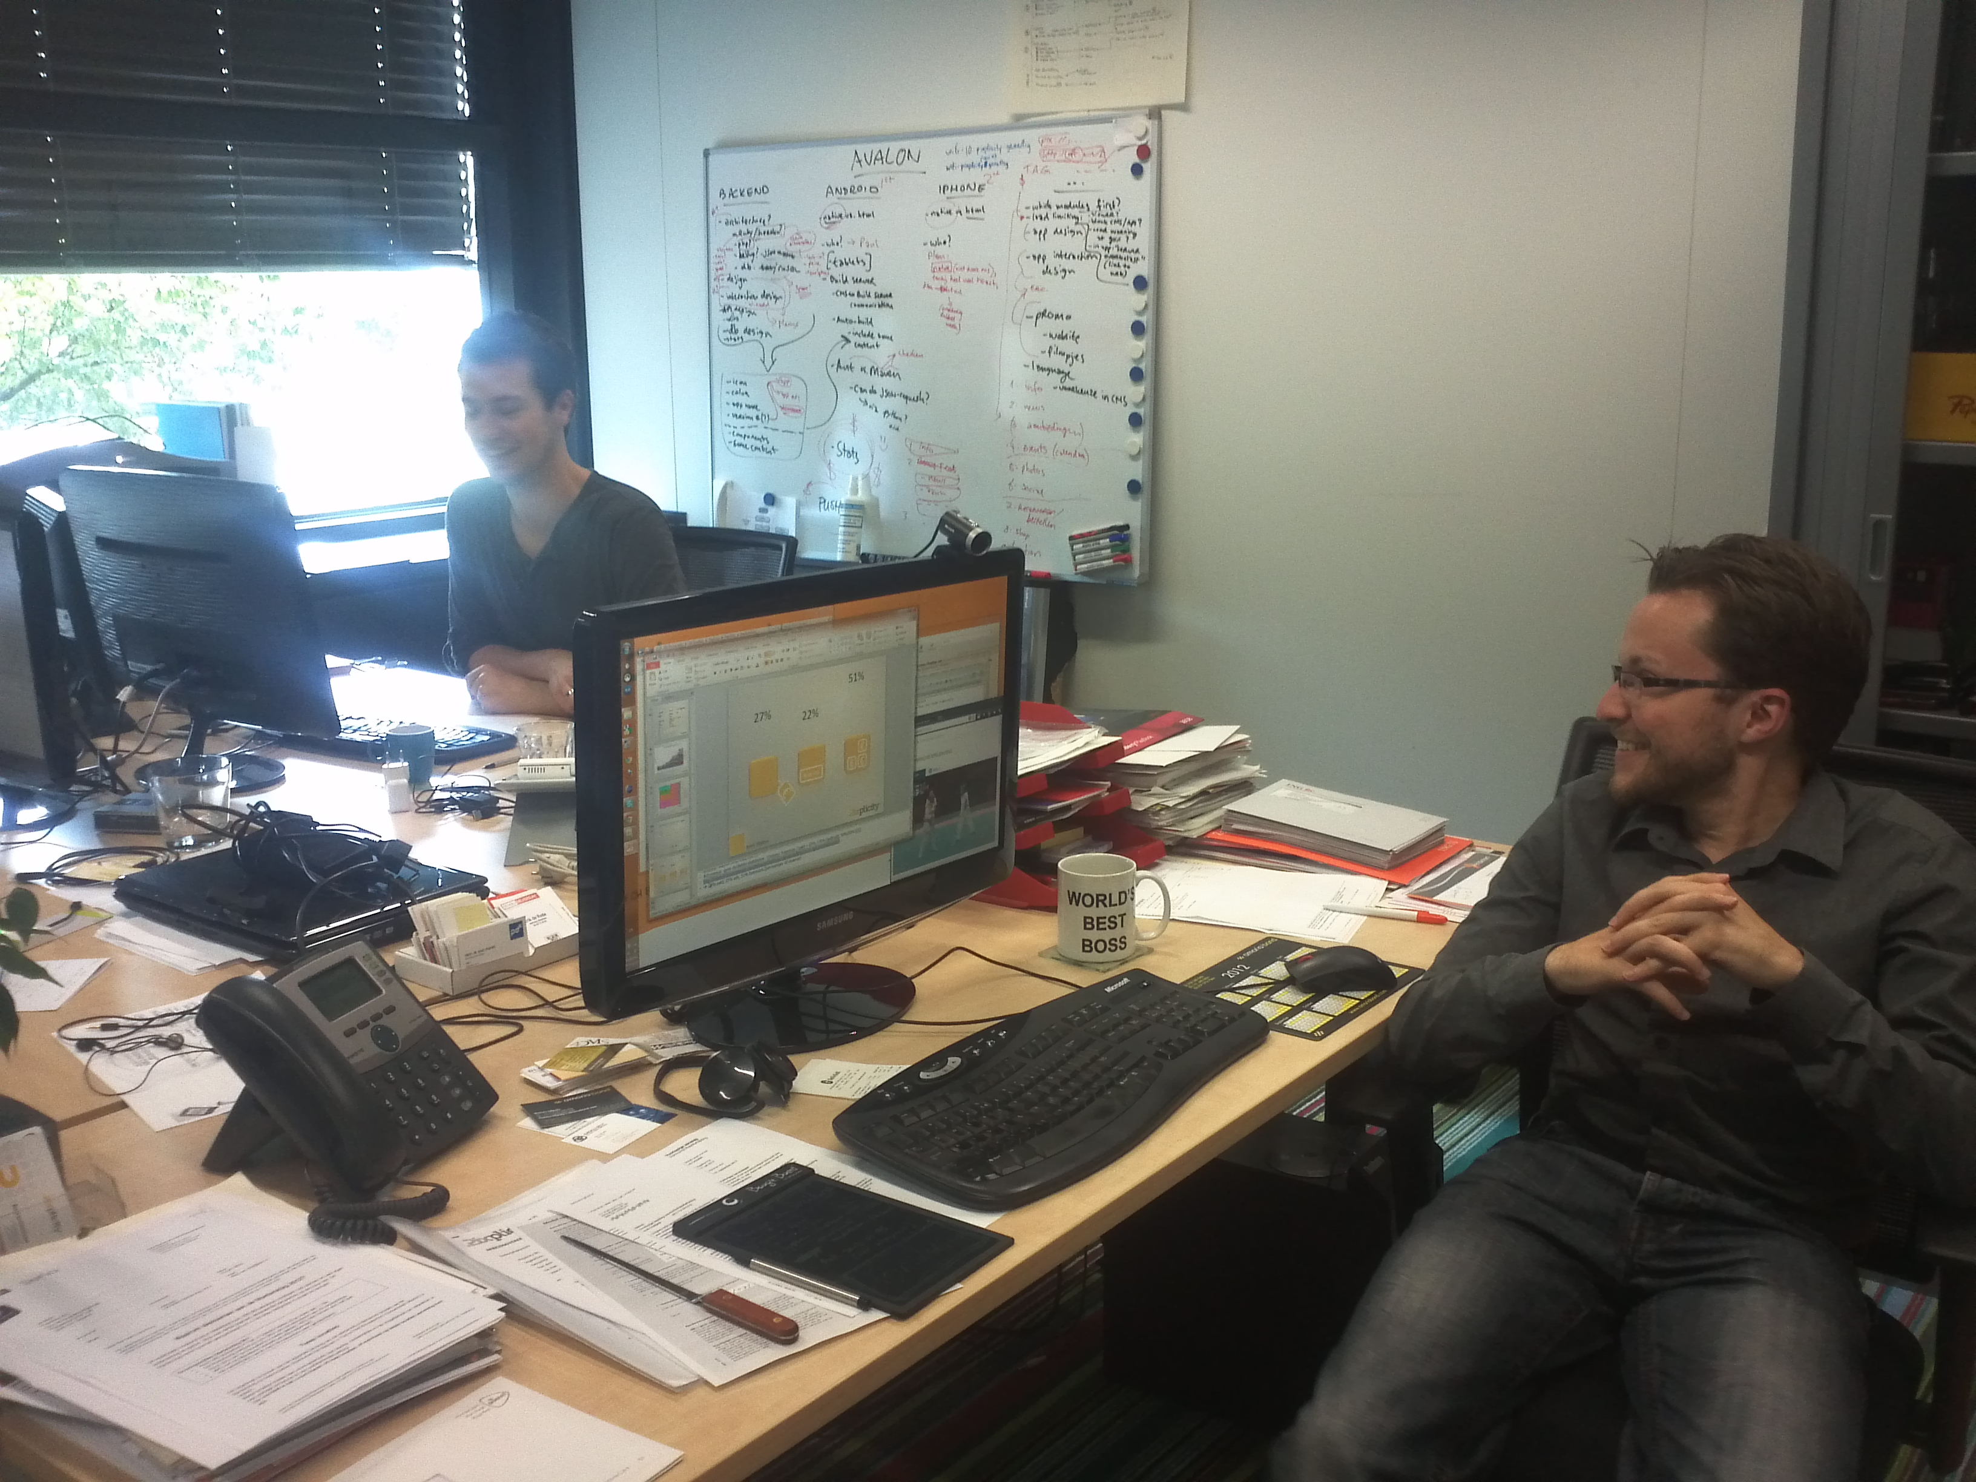
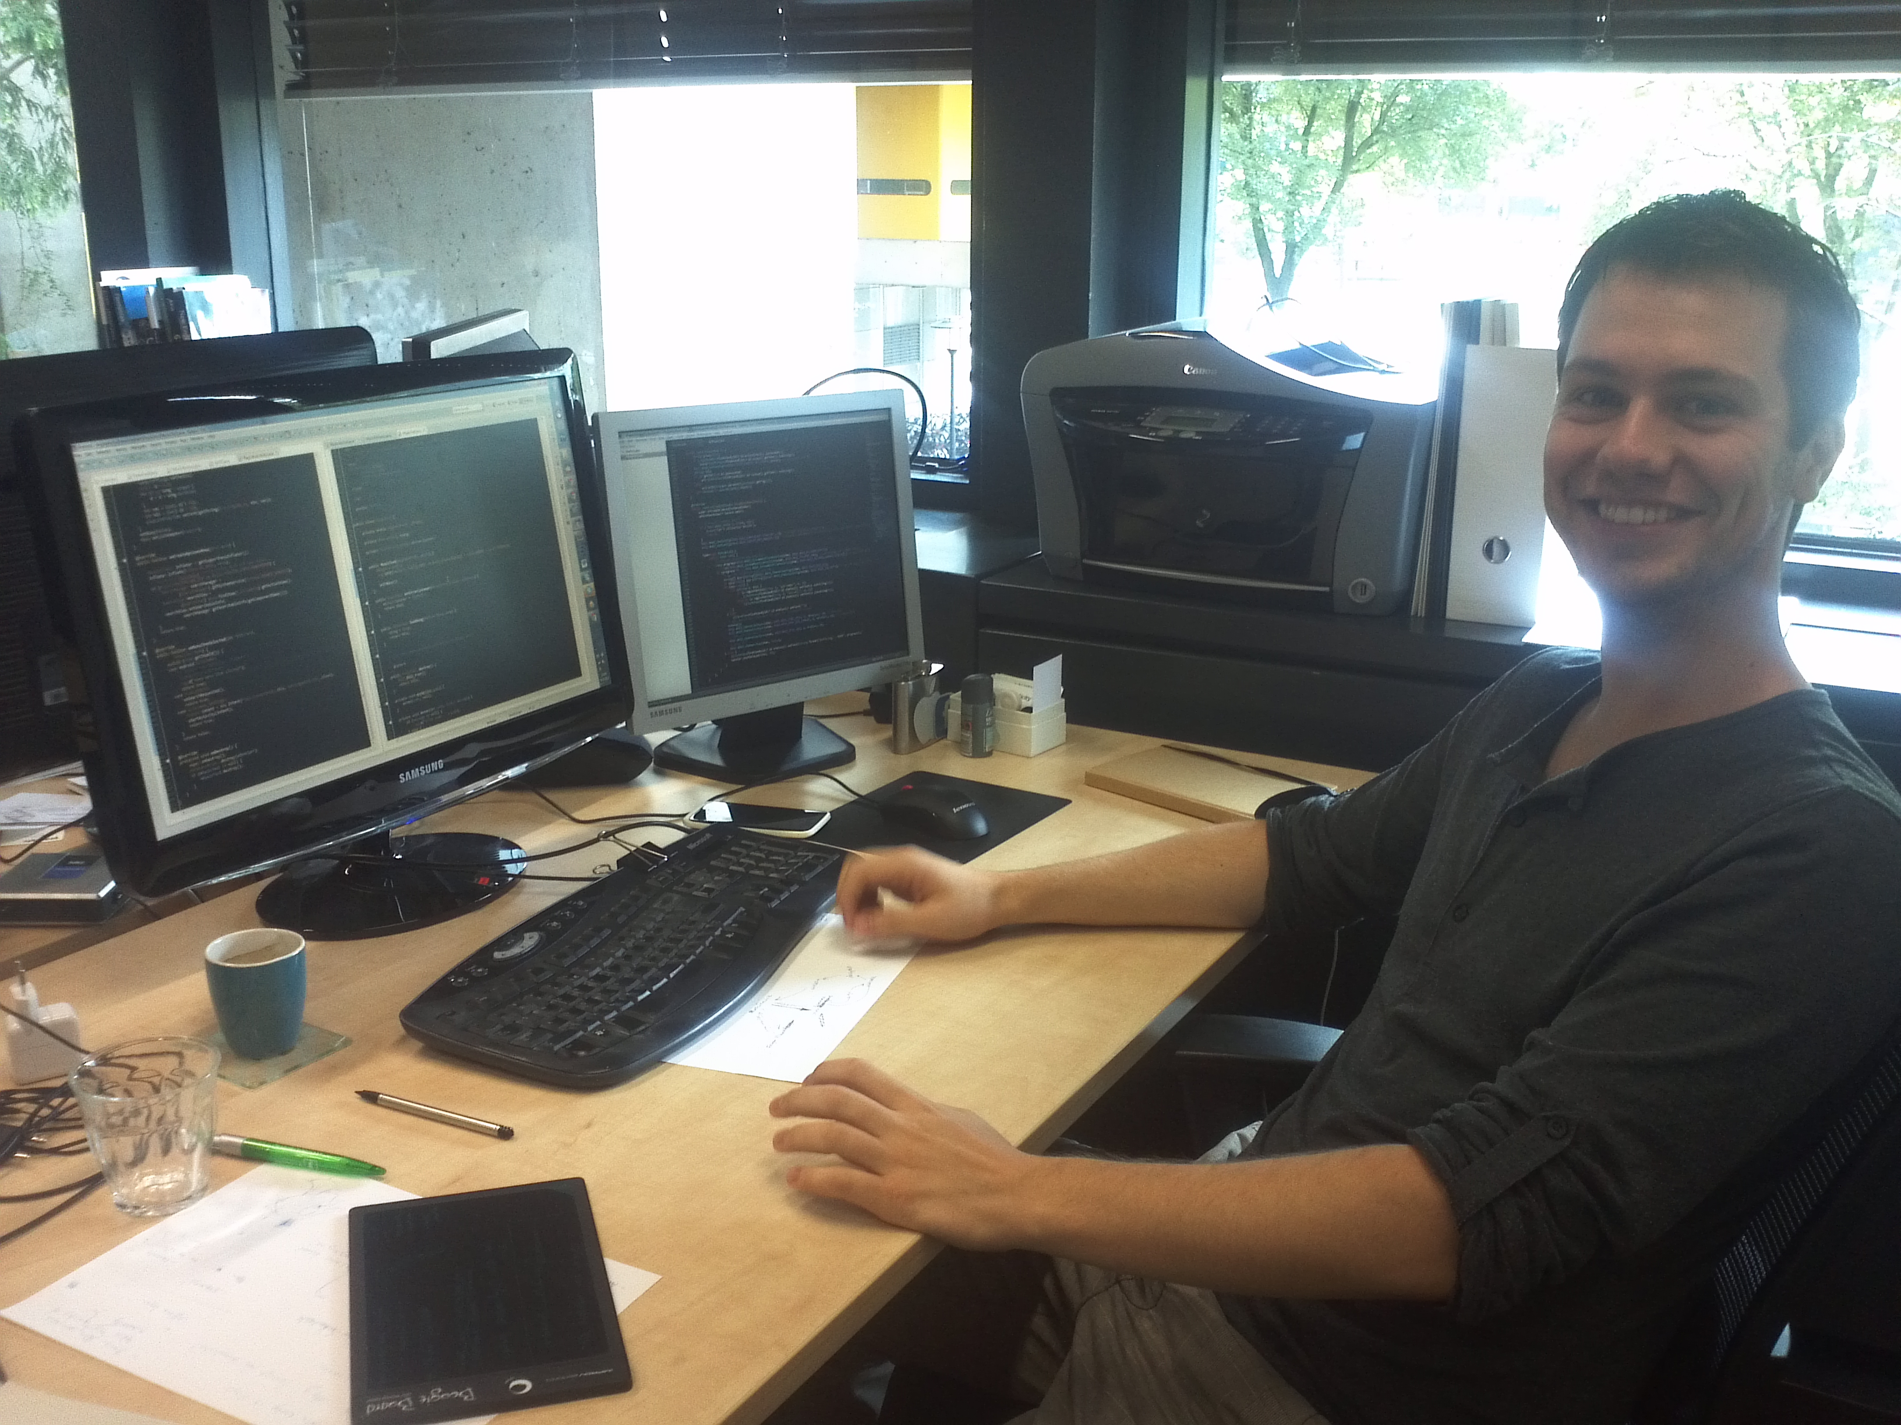
2008

Slide 7
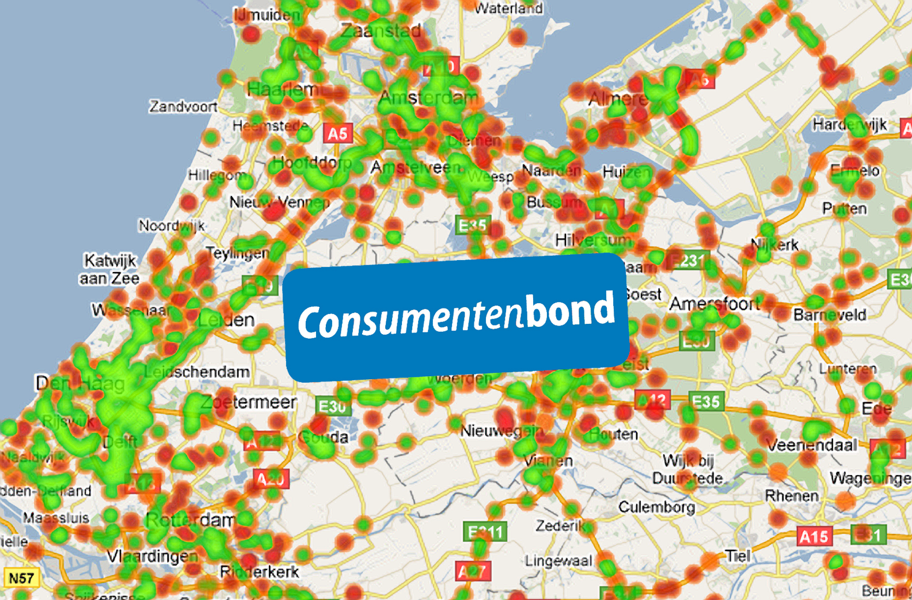
2009
Notes:
2010: we were offered an Android project, The Lowest Bill
Doing it ever since
We were the only one doing Android at the time
We live & breath Android, mobile apps are our passion

Slide 8
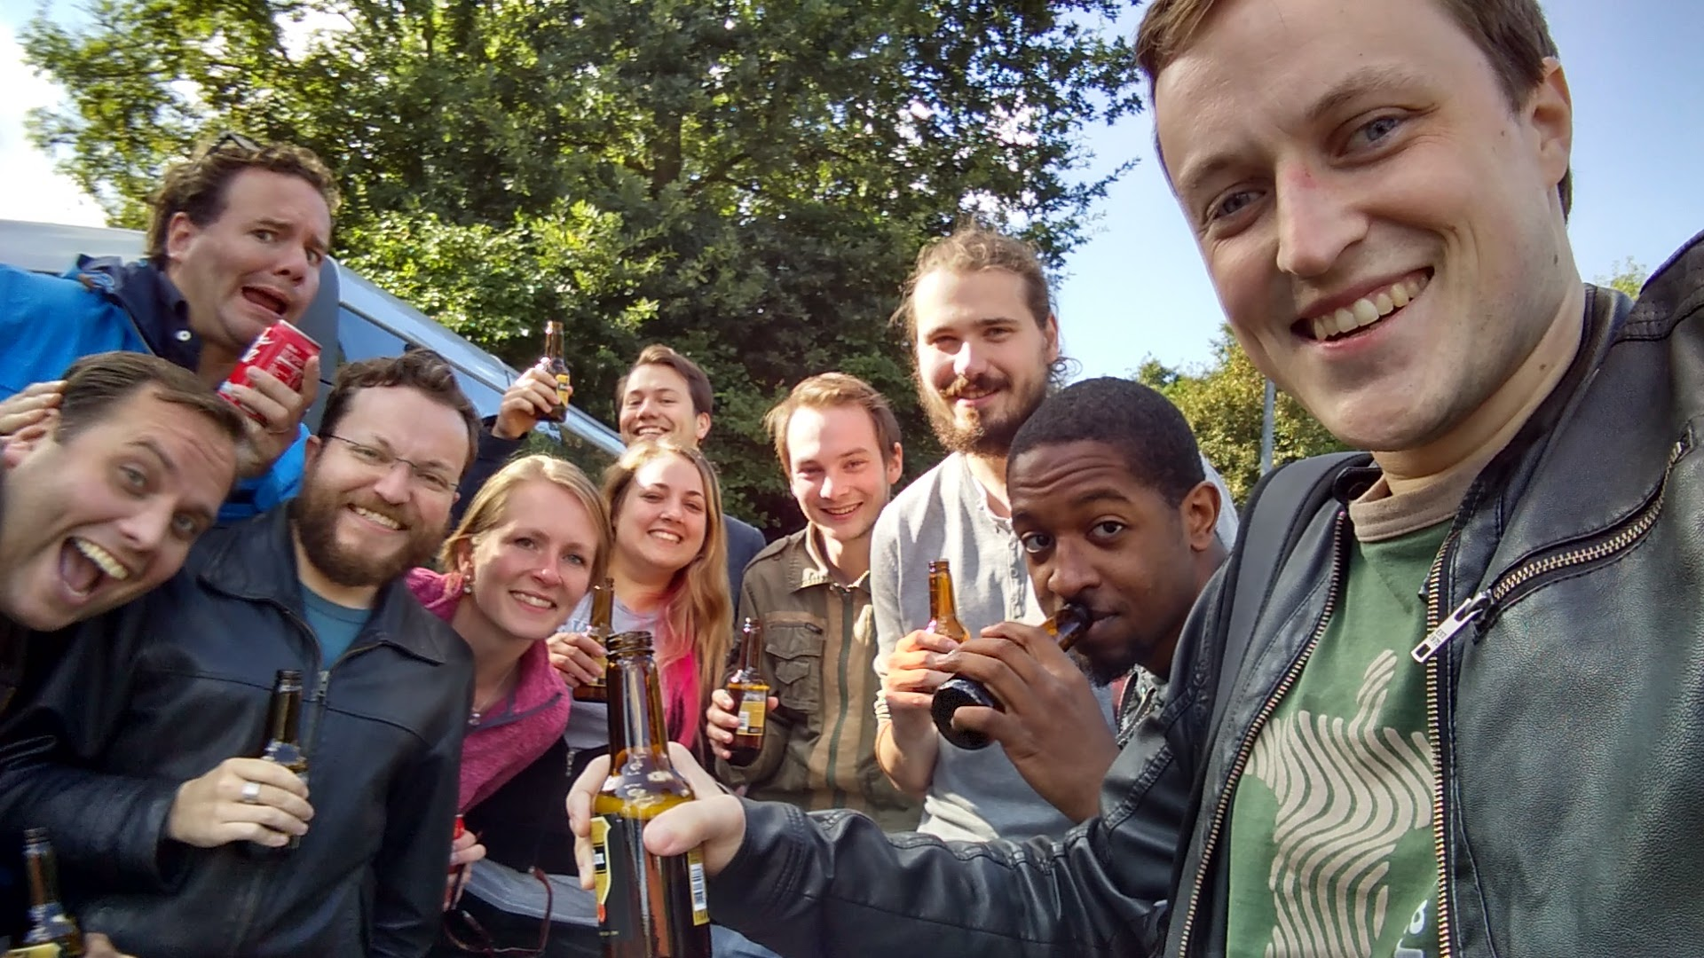

Pixplicity is a mobile innovation studio, where our key resources are top-tier technical knowledge and a passion for imagining and building great things. Projects only start when someone says “if we can actually get that to work, that’s going to be freaking awesome!”

Slide 9

2016
Notes:
We always dreamt of expanding to NYC. Two months ago, we did! Our CEO and CFO went on two sales missions and deemed the market as viable and lucrative.

Slide 10
Smartphones by the numbers
Notes:
2012: 1.0B
2011: 0.7B
2010: 0.4B
2009: 0.2B

Slide 11
Android by the numbers
1.4B+ 30-day active users
400+ OEMs developing for Android
500+ operator partnerships
1.5M devices activated daily

Slide 12
Google Play by the numbers
1B+ 30-day active users
65B+ app installs
2M+ apps

Slide 13
Users by the numbers
37.5 hours in apps per month
+65% from 2012 to 2014
26.7 apps used per month
+0.8% from 2012 to 2014
User engagement is growing

Slide 14
Users value high-quality apps
1 star review
50% of the time the user mentions the app stability and bugs
5 star review
60% of the time the user mentions the speed, design or usability

Slide 15
Attributes of quality apps
Useful features that users love
Beautiful design & ease of use
Reliability & performance
Latest Android features

Slide 16
Material design
Tangible surfaces and shadows
Rich imagery and bold colors
Meaningful motion
1M apps on Google Play

Slide 17
Material design dev stories
Fabric 30% increase in sign ups, 2x time in app
Domain 44% increase in installs, rating from 2.8 to 4.1
MusiXmatch 2x more active users, 2x time in app
The Hunt 35% increase of weekly users starting hunts
Wego 300% increase in monthly user retention
Trello 41% increase in activity per session
B&H Photo Video 5x increase of in-app orders

Slide 18
How did we “get good”?
1% inspiration, 99% perspiration
Challenge yourself
Bring variety to your projects
Push your own boundaries into new fields

Slide 19
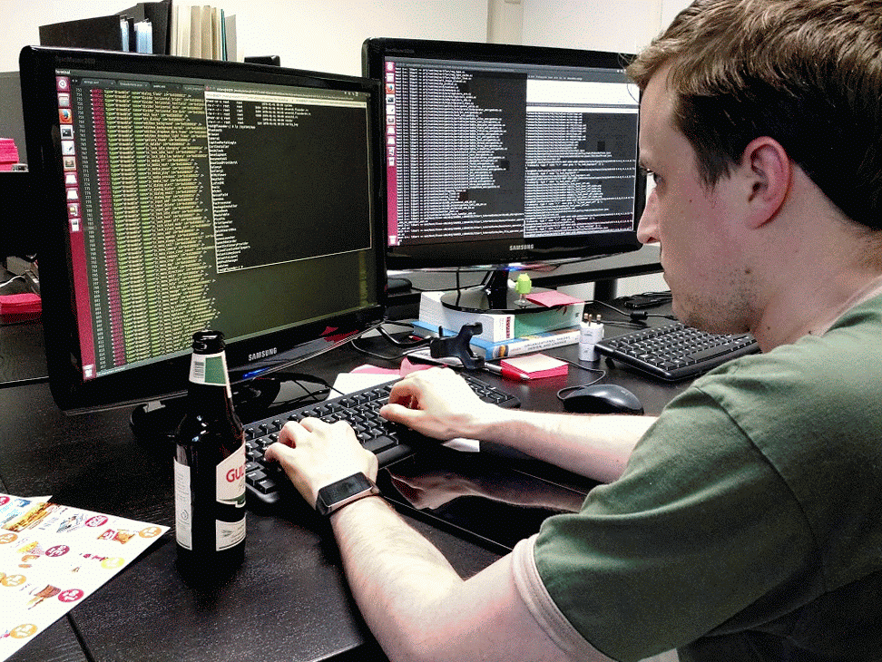
20% projects
We love tinkering and our tech demos are usually on the bleeding edge of what’s possible. Here, Paul is building the latest version of our own remotely configurable version of Android for use in Dutch elementary schools.
Notes:
… is going the next step and dive into the mechanics and blablabla do technologically advanced shizzle

Slide 20

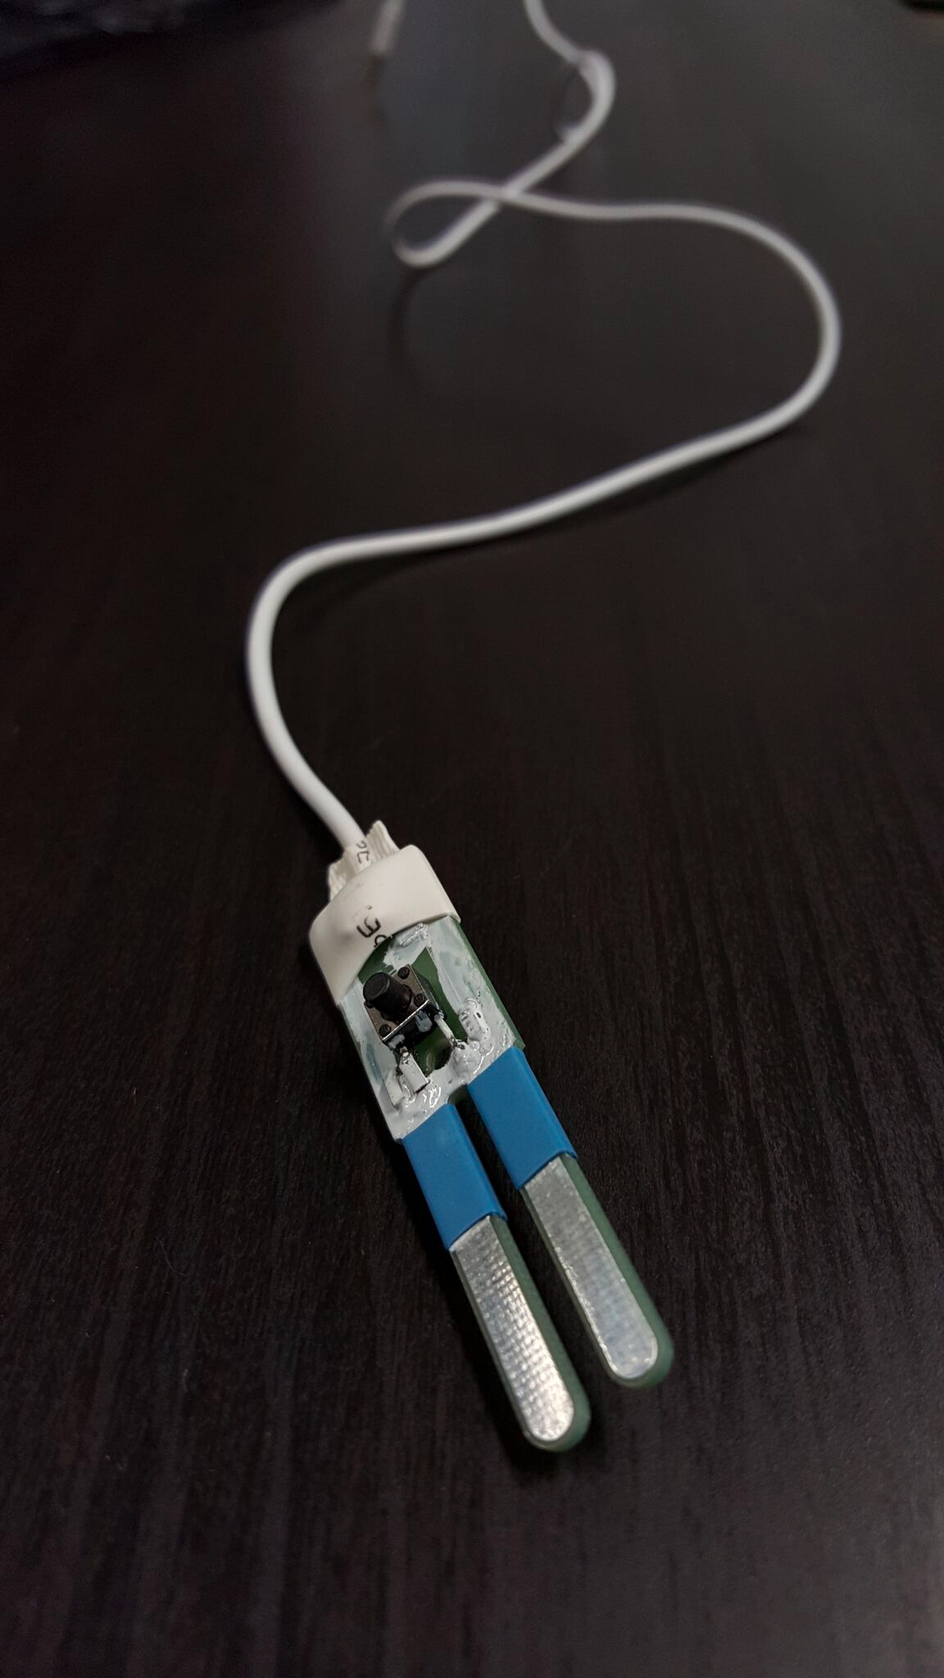



Together with Deltares, Pixplicity developed SWAPP, a mobile method for measuring water quality at extremely low costs in developing countries. Through basic circuitry communicating through an audio jack, farmers can use any cheap Android phone to quickly check whether their water is safe to use for irrigation.
Notes:
"Hoe de meter van Deltares via de koptelefoon zijn stroom haalt uit een toon en via de microfoonkanaal de meten terugstuurt, maar dat we er zo achter kwamen dat iedere telefoon, zelfs identieke, verschillende meetwaarden kunnen geven en dus softwarematig en automatisch geeikt worden. Ook supergaaf. "

Slide 21

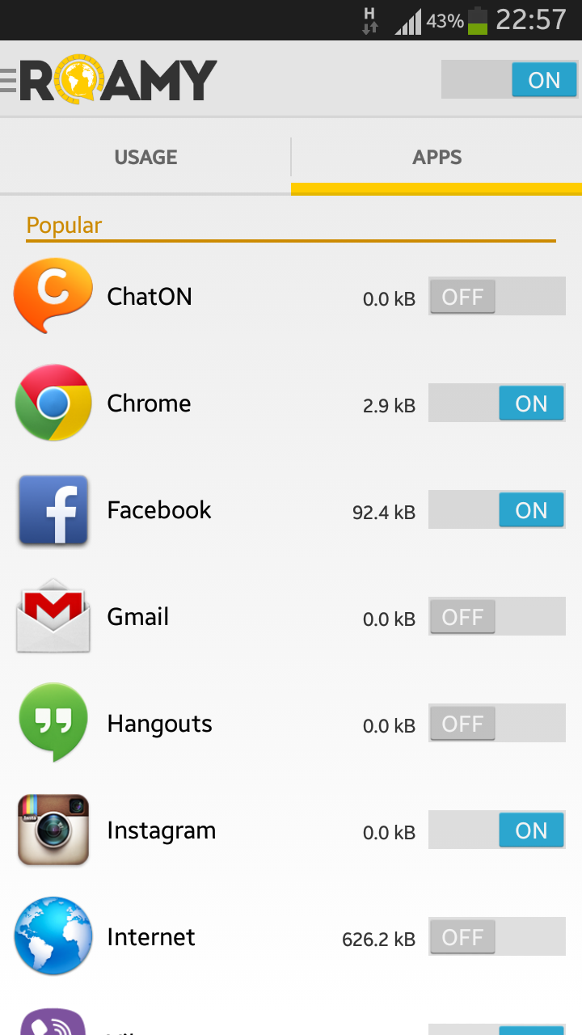
Current work
We had at first though that building an app that controlled other app’s data usage would be impossible, but “Roamy” does just that! It allows users to control data usage more granularly by whitelisting apps they wish to use while traveling. The app uses a local VPN connection to control network traffic.

Slide 22
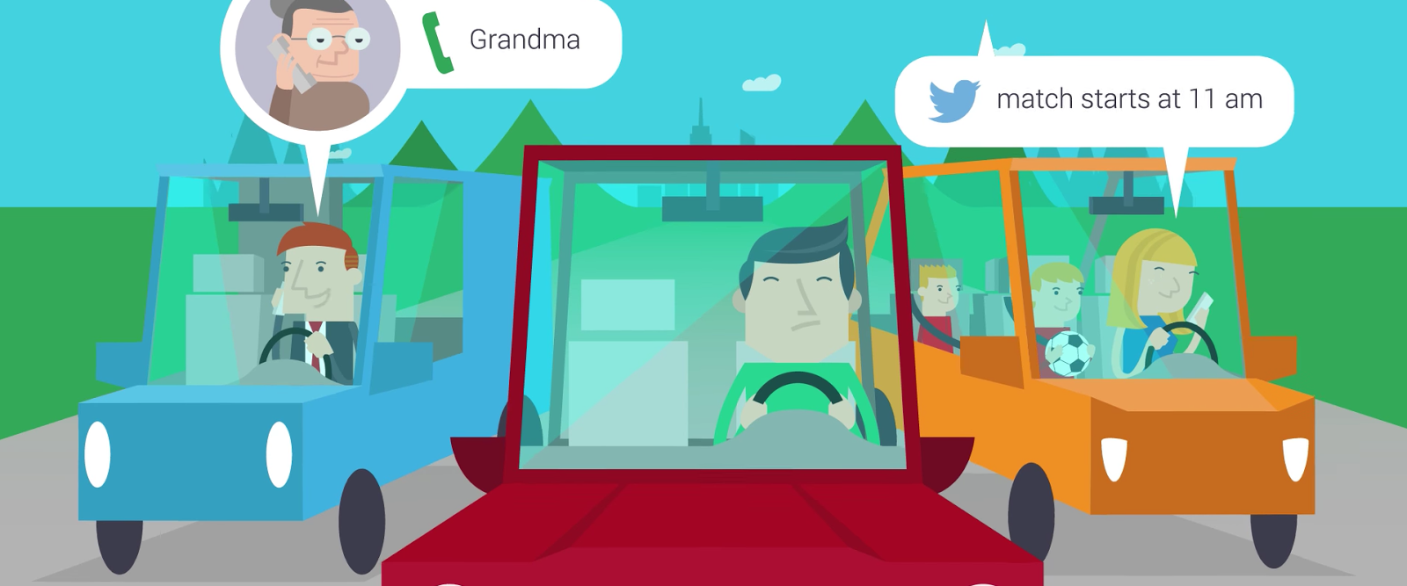
Current work
“Drive Safely – Keep Focused” is an technically challenging app that prevents all mobile distractions while driving. It blocks notifications, alarms, calls, messages and even the display for everything but navigation. Essentially, it does a lot of things an app probably shouldn’t be able to – to ensure that you’re a safer driver.

Slide 23

Current work
As Android gurus often working for some of the greatest, flashiest brands and agencies, most of our biggest clients and largest projects are under NDA, but we’re happy to discuss some in person!
Notes:
Of course we always aim to get the best quality, speed, design, blabla in our apps. Unfortunately, many of our projects I can't talk about because of NDA's….

Slide 24

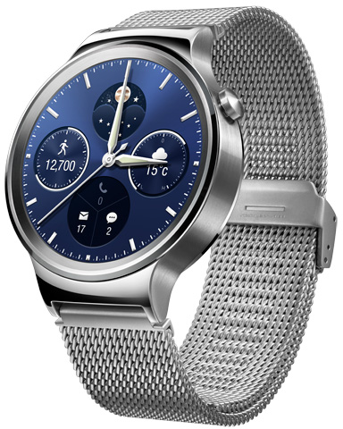
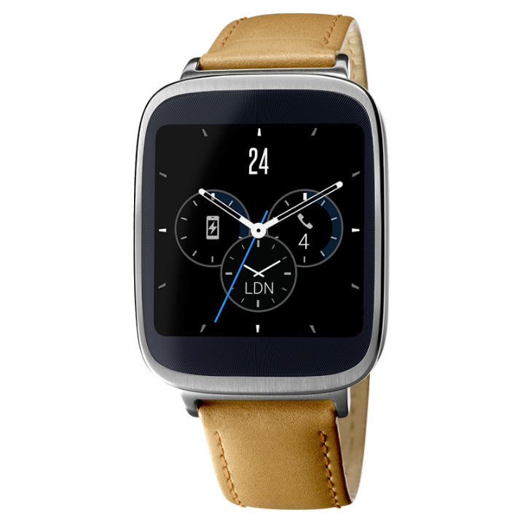
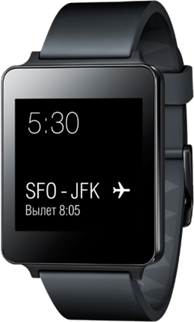
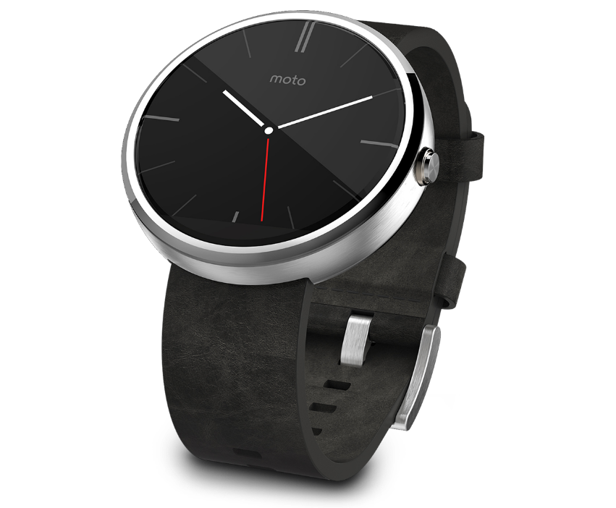
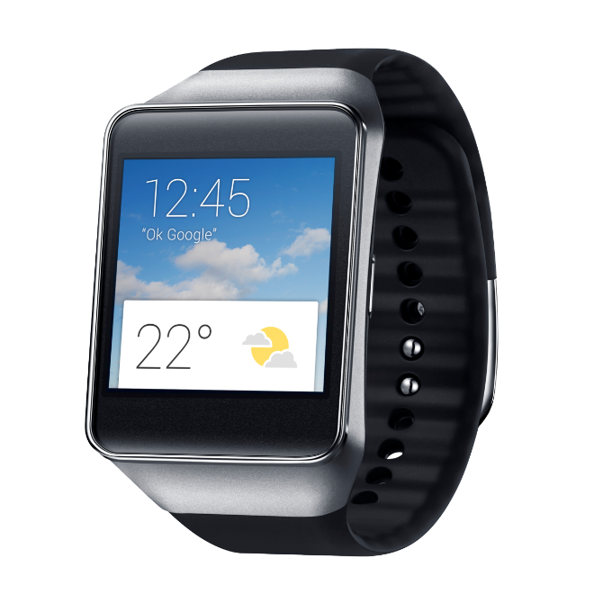
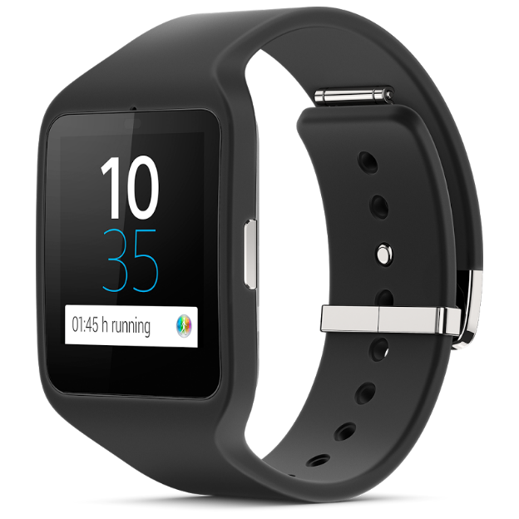
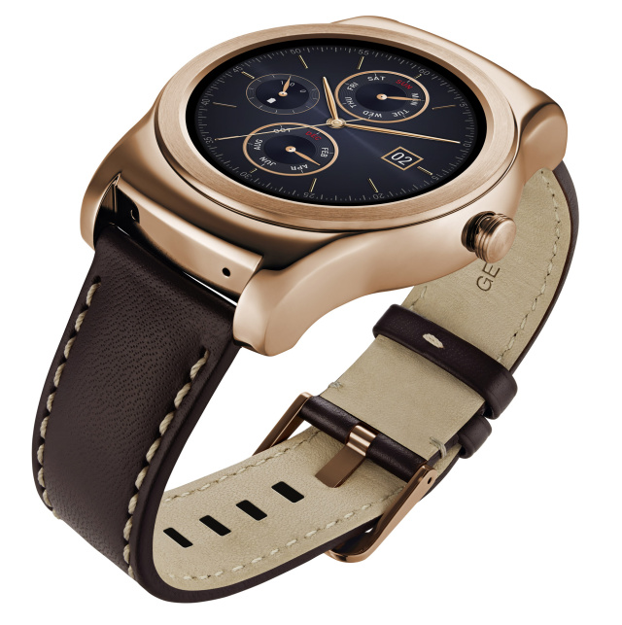
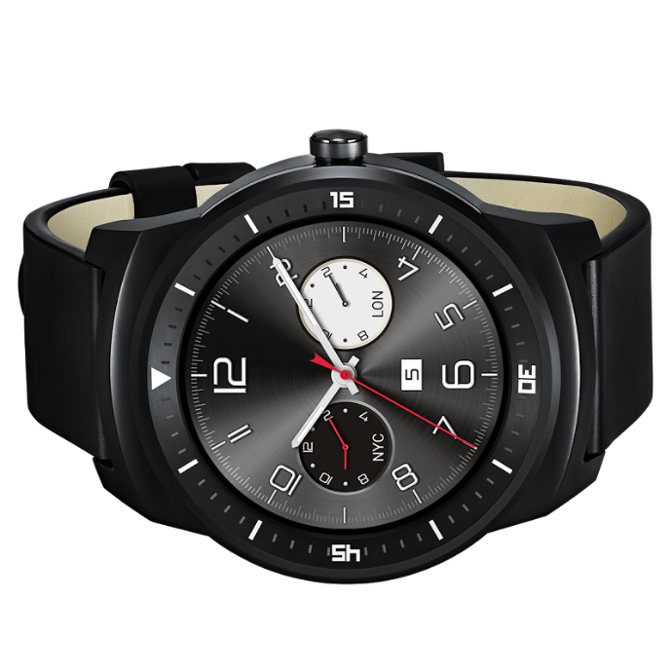
In the past year, we’ve built over 20 watch faces and watch apps for some of the biggest brands in the world. These range from innovative design-focused faces, to highly functional, interactive apps that make smart use of tiny screen real-estate.
Notes:
… but we made a shit ton of awesome apps for a wide variety of devices, including smart watches, cars, blabla. And they all look amazing. But it doesn't stop at looking amazing, because what we really love doing at Pix….

Slide 25
Understand the app goals
Loyalty
Relationships
Accessibility
Functionality
Notes:
Client acquisition: mobile strategy
Loyalty: Getting customers to come back essential for growth. Returning users are happy users.
Build long lasting relationships with your users. Don’t treat every user the same; they should feel as if they have a unique relationship with the brand. Provide a satisfying experience. Incentives, such as coupons.
Users won’t land in your app by coincidence, like a website. They are looking for that content and service in the app they’ve downloaded.
Content is king. Users turn to your app to get access to content and receive services they cannot otherwise find online or offline. Reward your users with allowing them to access that easily!
Make sure the functionality they want is accessible to them.

Slide 26
Ask key questions
Which in-app actions & user behaviors matter most?
What does the app mean for the client?
What’s the value of an active user?
How are you optimizing the user experience?

Slide 27
Measure
Identify valuable users
17% of users generate 85% of app revenue
Understand how users behave in the app
Turn insights into marketing actions
Measure campaign performance

Slide 28
Measure
Installation referrer
Sessions
Engagement with notifications
Causes of removal
Specific events fitting the app goals
Notes:
Games: finishing a match, leveling up, spending (virtual) currency, unlocking achievements
eCommerce: search results, item details, adding to cart or wishlist, begin checkout, adding payment details

Slide 29
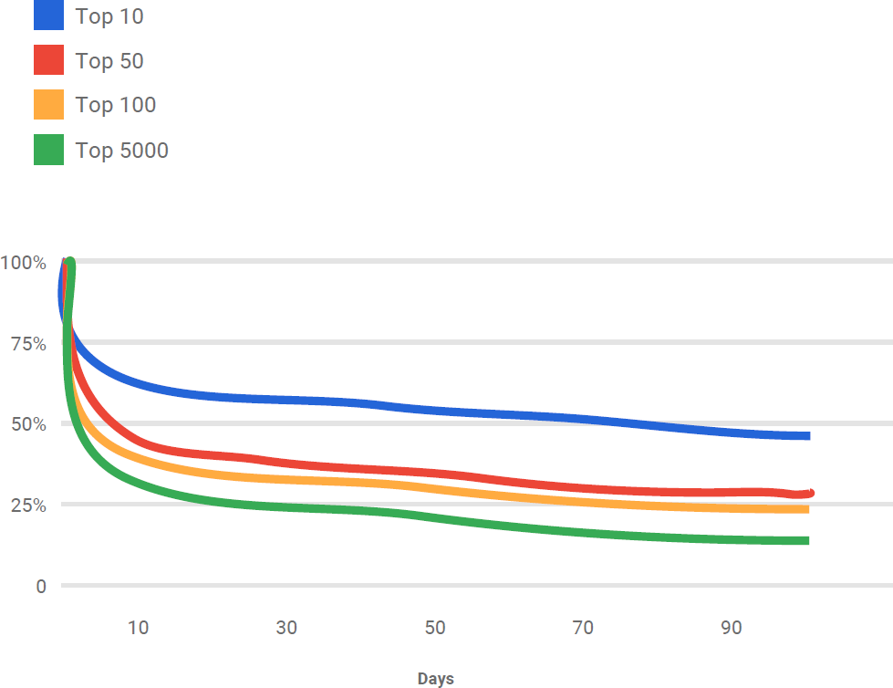
First impressions matter
There will always be a sharp decline in users, but a quality app will retain engagement by up to 250%

Slide 30
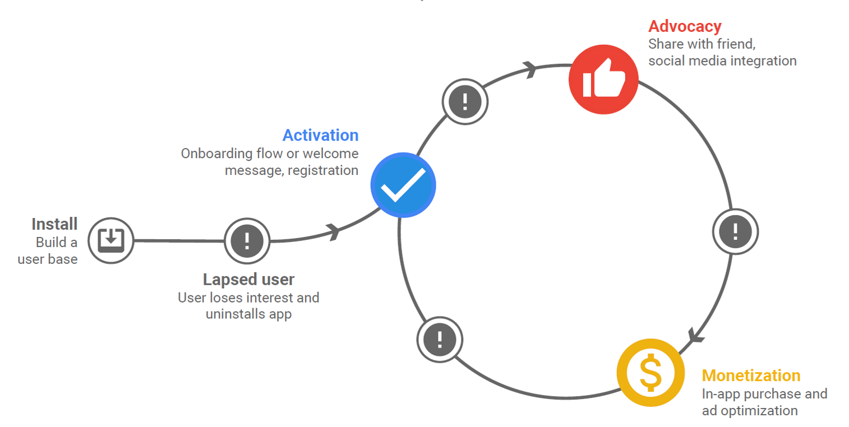
Drop-off points

Slide 31
Frictionless onboarding
Onboarding Allow users to authenticate using sign in easily
Payments Allow users to pay through Google Play, Google Wallet or PayPal
Notes:
Sign in using Google, Facebook, Twitter

Slide 32
Engagement through notifications
Rich notifications
Actionable content
Deep link to the right part of your app
Stack similar notifications and avoid spamming
Don’t treat all users the same
Test!

Slide 33
User retention
eCommerce
Measure short term: searches and purchases
Stimulate: rewards/loyalty program
Measure long term: transaction revenue
Notes:
Example of Jet

Slide 34
User retention
Service industry
Measure short term: accessing & engagement with services
Stimulate: upgrade or buy additional services
Measure long term: service cost reduction and increased revenue
Notes:
Example of Pocket Agent

Slide 35
User retention
Digital services
Measure short term: accessing & engagement with media
Stimulate: relevancy and sharing of content
Measure long term: referral subscriptions
Notes:
Example of Hulu

Slide 36
Measure
Use powerful tools
Firebase Analytics
Google Analytics for apps
Notes:
Also consider that these tools can hook into established ad networks

Slide 37
Testing
Test on a multitude of devices
Use the Cloud Test Lab
User testing through open or closed beta
Beta reviews and ratings stay private
Continuous integration with tests

Slide 38
Stand out
Store listing
Experiment what works best with A/B tests
Showcase features in screenshots & videos
Reach your demographic
Invest with AdWords, Facebook ads and promoted Tweets
Notes:
Store listing:
Unique, compelling, snappy.
Header image/video. Icon. Description. Key images (screenshots).

Slide 39
Monetize
In-app purchases
130 of 190 countries with Google Play
21 countries with PayPal
Subscriptions are the fastest growing business model
250% increase from 2012 to 2014
47 countries with direct carrier billing

Slide 40
(Don’t?) Monetize
90% of users want free apps
Paid apps constitute 1% of apps
Quantify the value of your customers
Ask key questions
Does the app increase customer loyalty?
Does displaying ads match our mission statement?

Slide 41
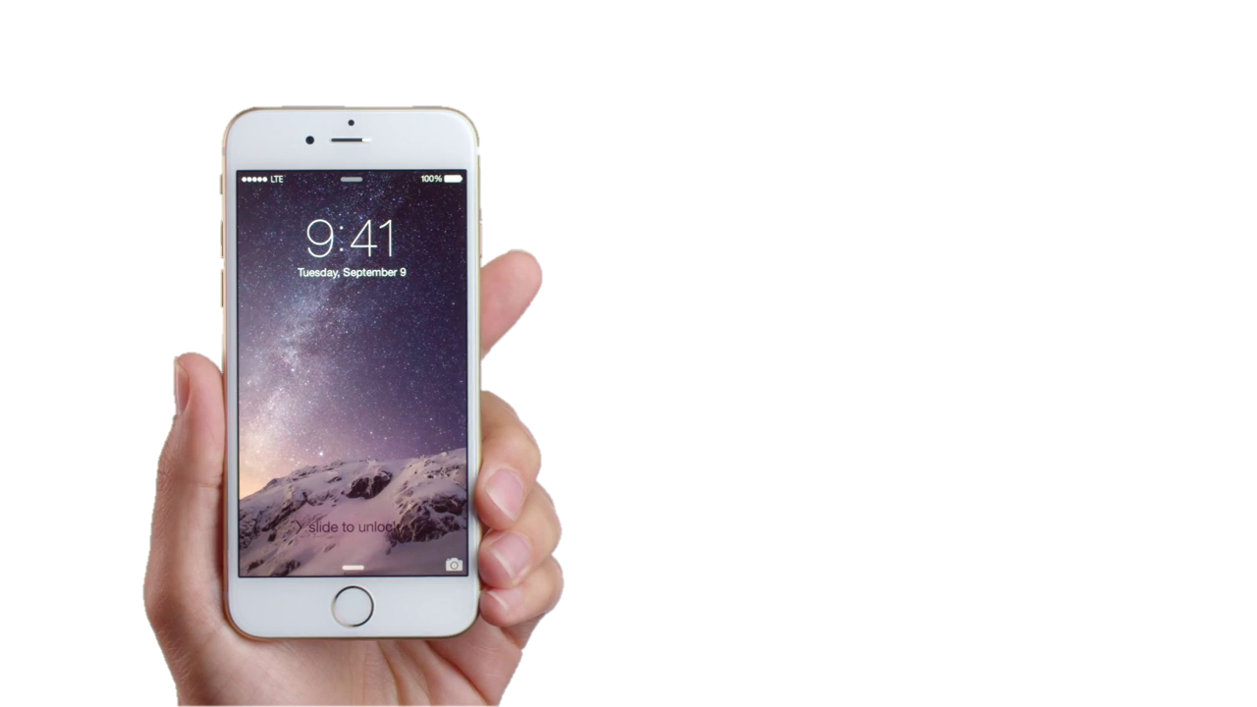
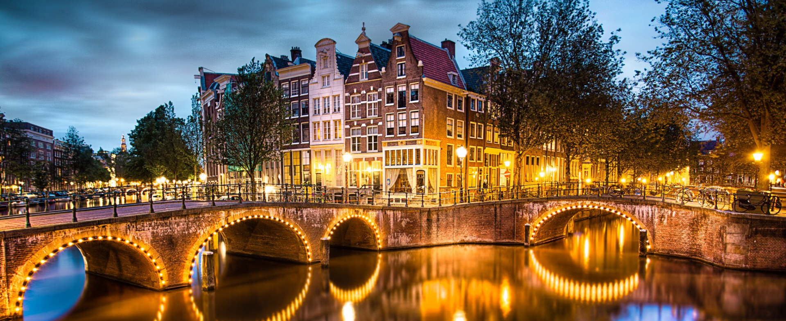
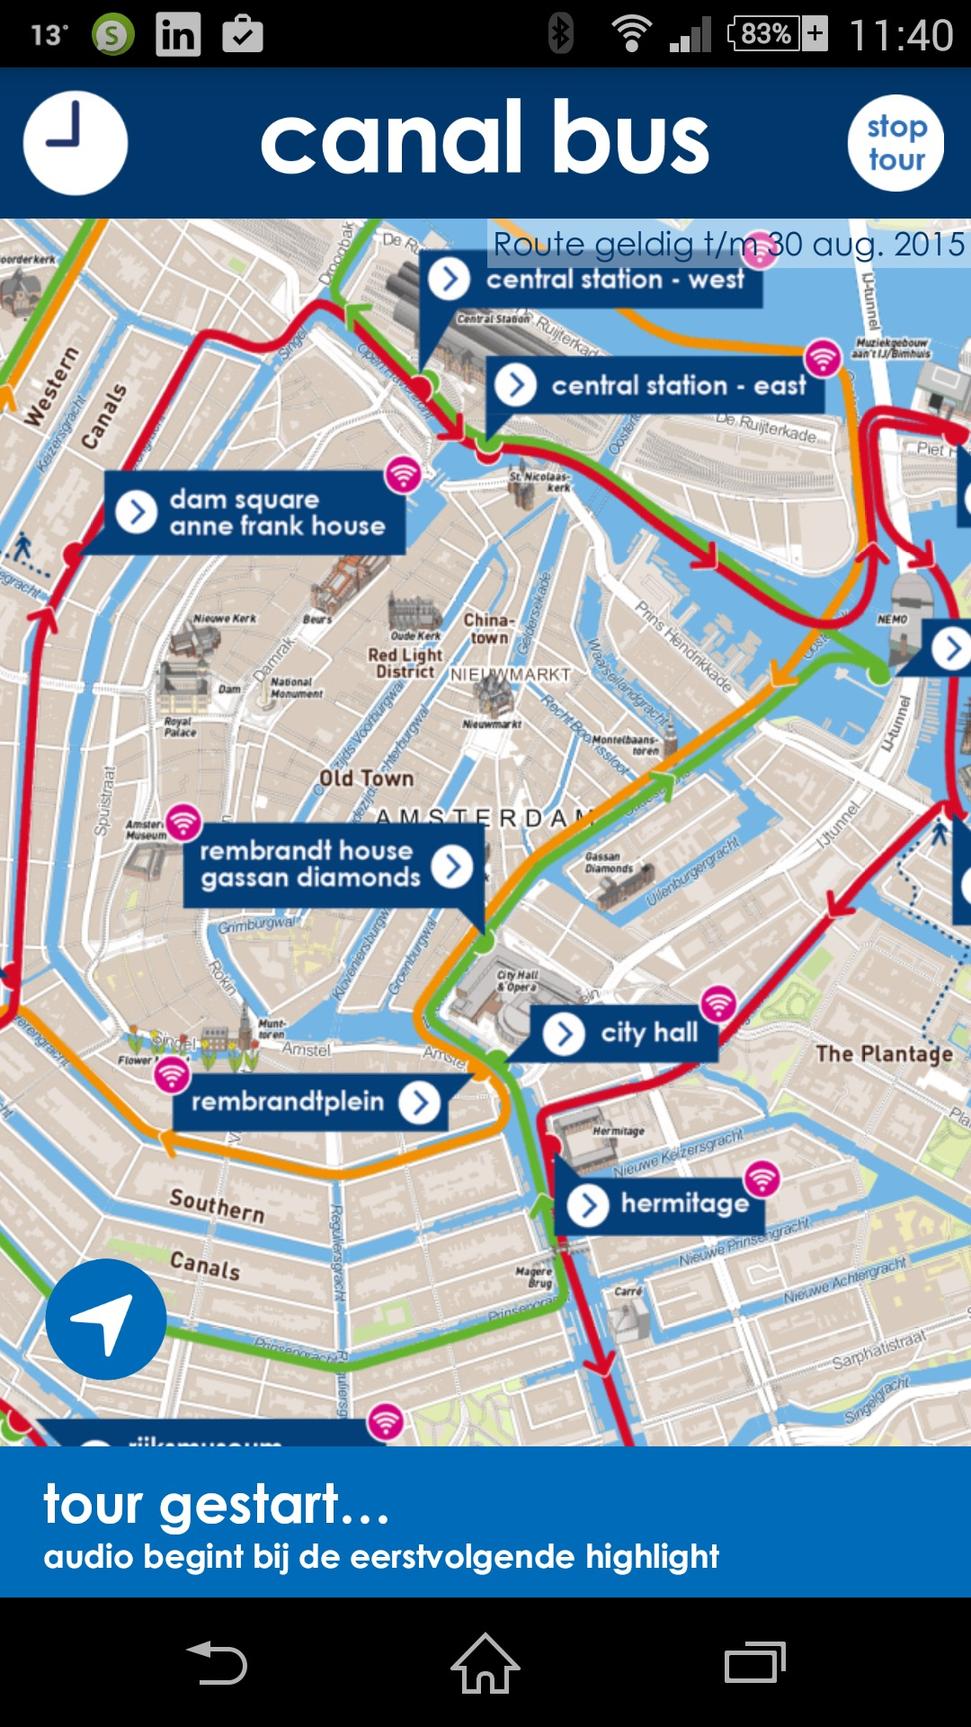
Pix Tours
One of our bigger in-house projects is a complete platform for location-based tour experiences, providing businesses, municipalities and other digital agencies with easy, low-cost ways to create multimedia tours and manage content.

Slide 42
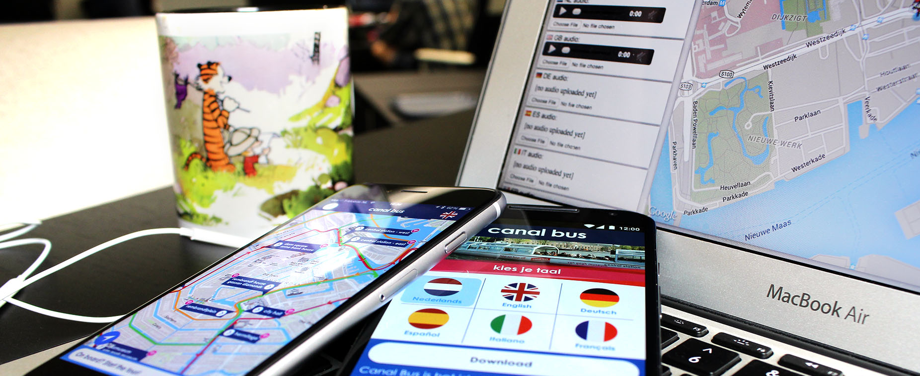
This system is already used by Amsterdam’s major canal boat operators to serve and manage fully automated audio tours to (offline) tourists from around the world. With zero technical knowledge, they moved old tours online in 24 hours.

Slide 43
Engage with the community
Open source
Share knowledge
Attend events
Organize events

Slide 44
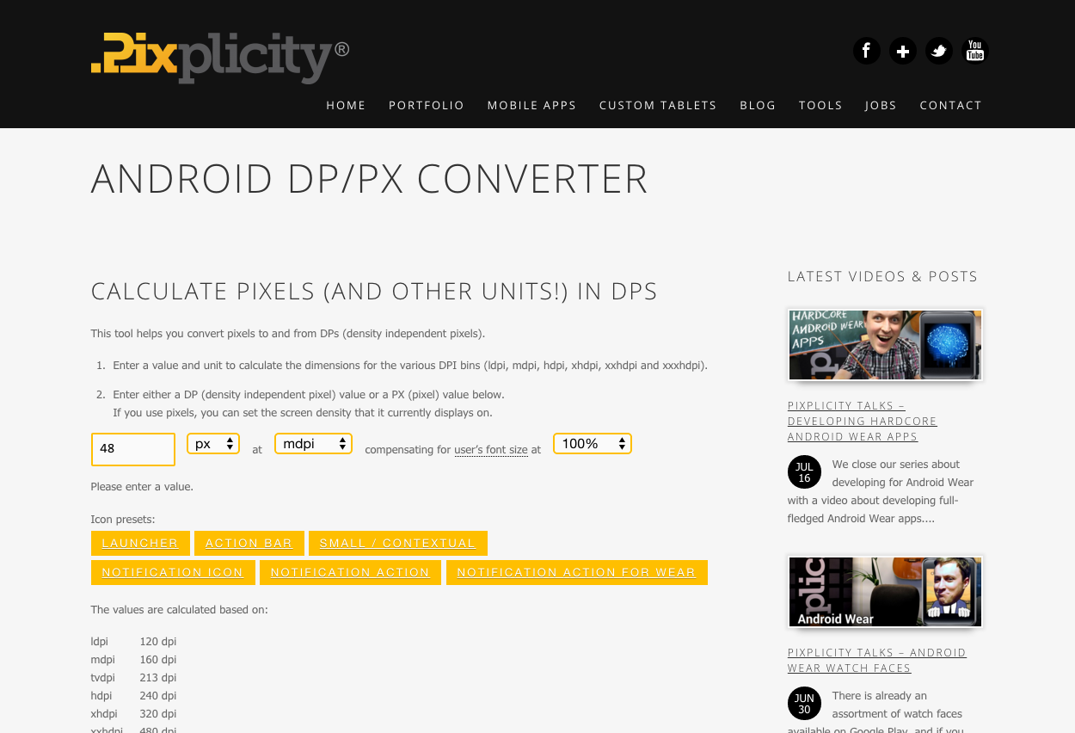
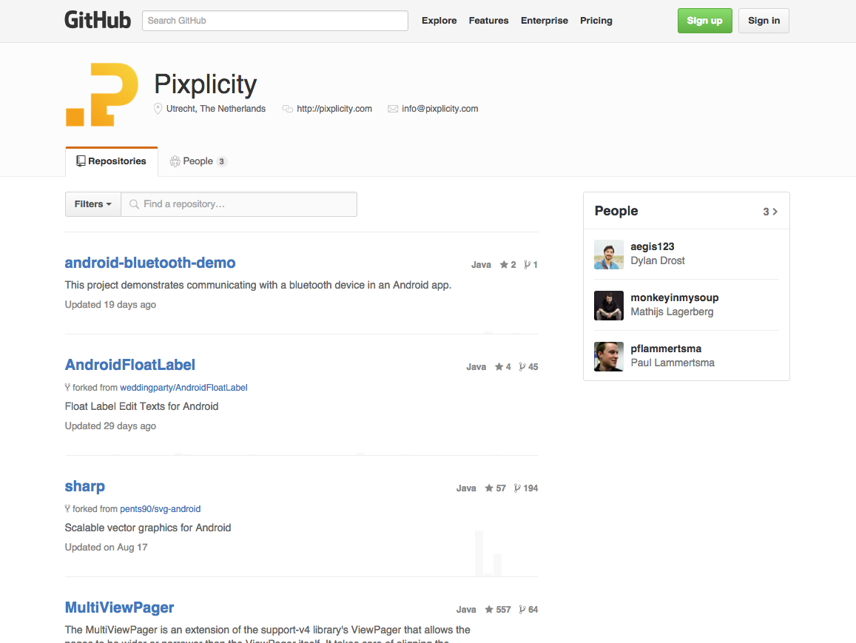
Sharing expertise
Every time we create tools, code, principles or guidelines to increase the quality (and ease) of our own work, we open them up to the world to help improve apps everywhere. We currently have nearly 30 open-source projects on GitHub!
Notes:
Google Cast
Android Wear
Libraries (

Slide 45
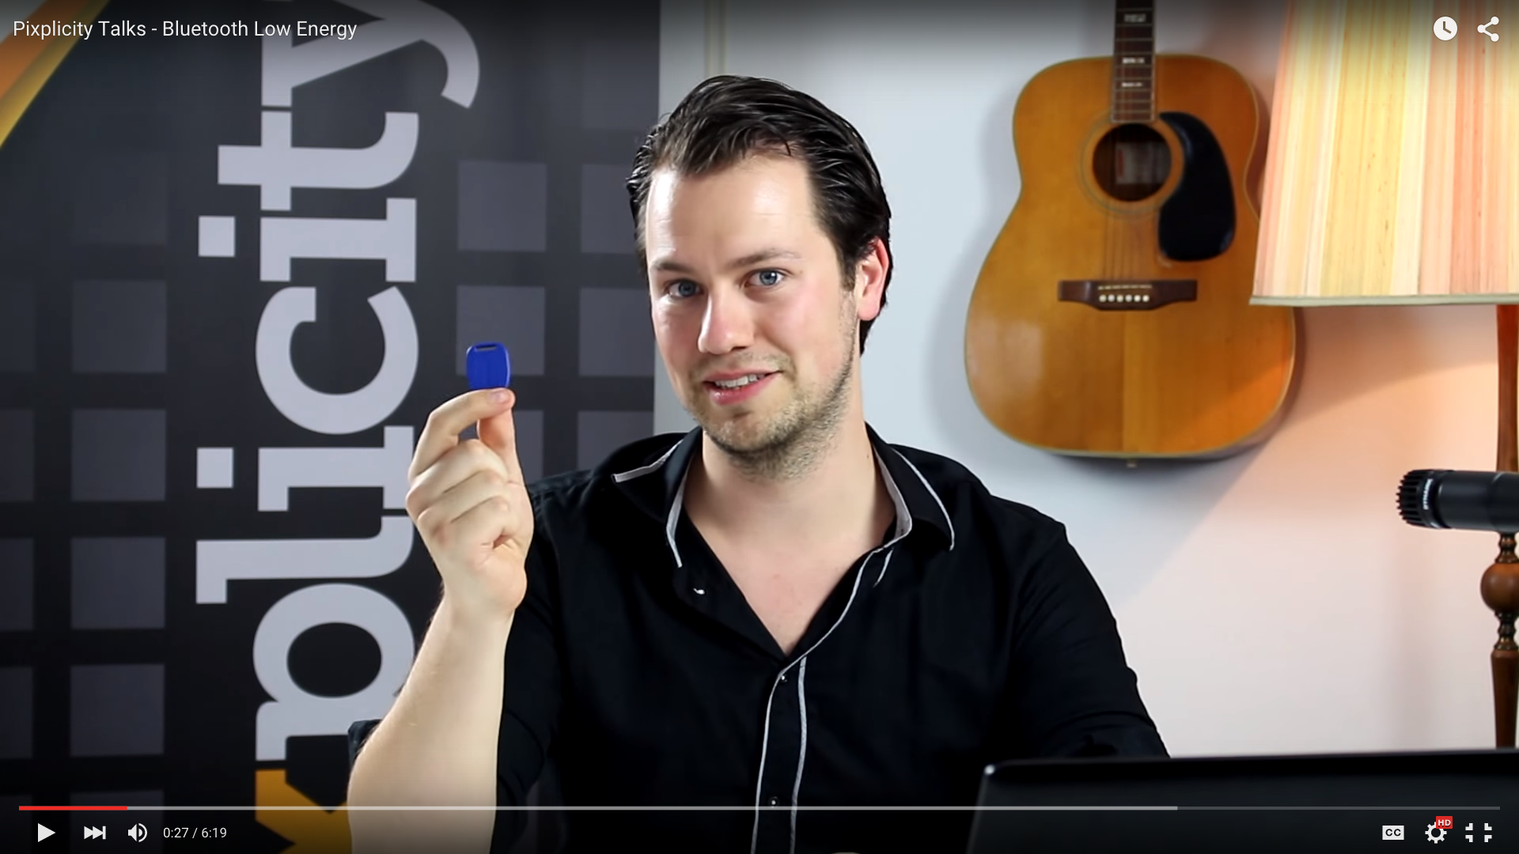
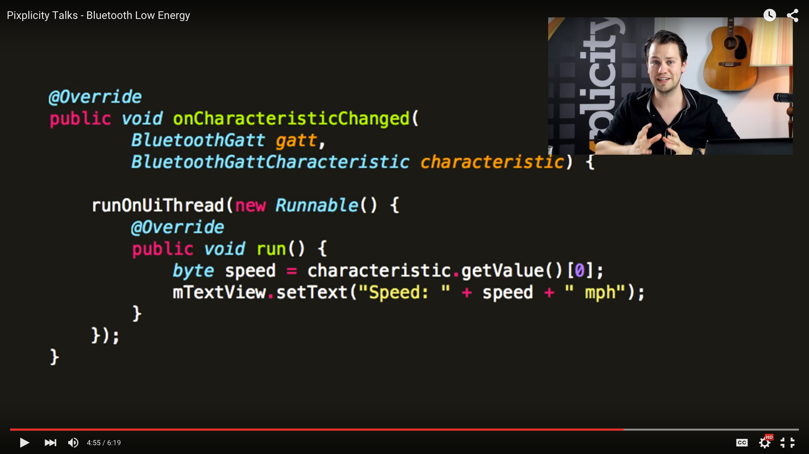
Sharing expertise
On our YouTube channel we make exciting topics such as Android Wear, Bluetooth Low Energy, and customizing the Android OS itself more accessible. We introduce the basics for newcomers and then dive into the details in multi-episode series.

Slide 46
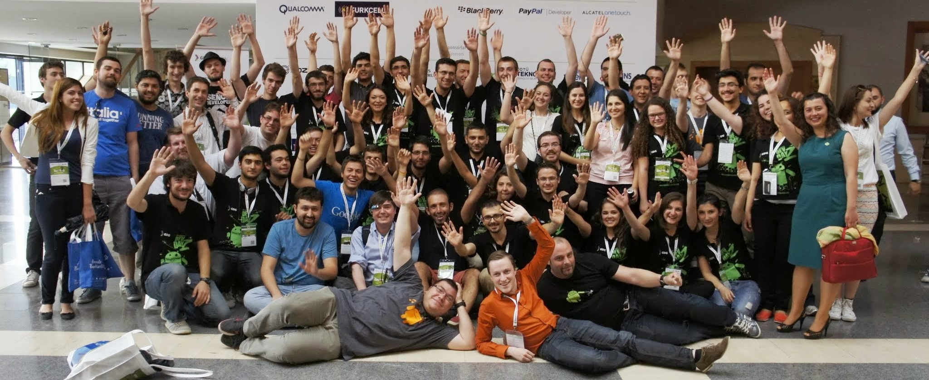
Community involvement
Meeting all technology affectionados is incredibly valuable to us. It’s not only a fantastic pool of talent which we lead and bring together but, more importantly, a pool of extremely interested, motivated and inquisitive people.

Slide 47

Food!
As you’ve probably gathered, we’re an extremely nerdy bunch, but we love to share everything we do. You can always approach us to talk about tech, marketing and mobile, and we’ll let you in on some of that top-secret work!

Slide 48
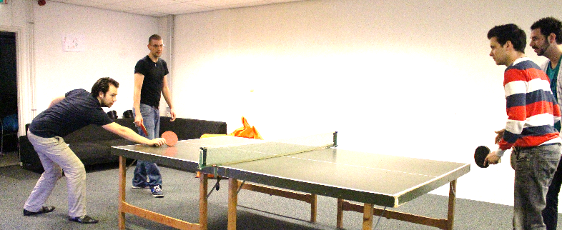
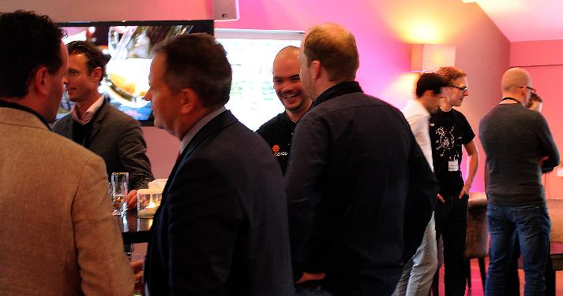
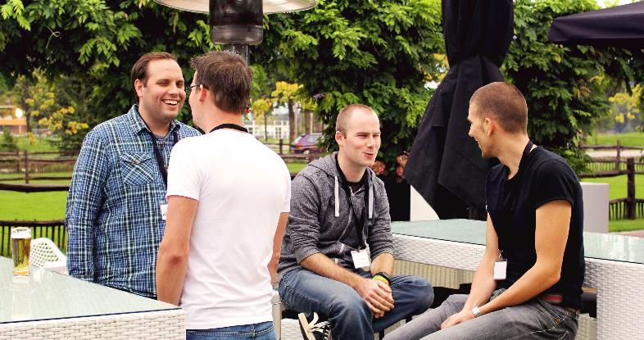
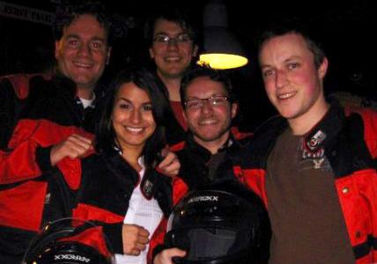
Most of all, we enjoy our work!
Notes:
Fun!

